Slide 1


Trade Patterns and Global Value Chains in East Asia: From Trade in Goods to Trade in Tasks
June 6, 2011
WTO, Geneva
Dr. Robert Koopman
Chief Economist
U.S. International Trade Commission
The views expressed are those of the author and may not represent the views of the USITC or its Commissioners.

Slide 2
I would like to thank Mr. Escaith, President Shiraishi, and Director General Lamy, for the opportunity to comment on this joint WTO/IDE JETRO publication, and to participate in the discussion of the paper with Mr. Nakatomi, President of JETRO
I congratulate them, and their teams for this very valuable contribution to improving our understanding of trade and its various impacts on economies around the globe.

Slide 3
This is a clear, comprehensive, thorough, and insightful publication that will help inform policymakers, researchers, and business leaders about an important aspect of changing global commerce.
This is an important topic and as we learn more could help change how we discuss trade and its economic impacts, from standard data reporting to economic models and theories.
The publication provides a brief summary of the global supply chain literature and helps “connect the dots” to infrastructure services, tariff policies, FDI, and some insights on employment.
It then goes deeper in an interesting and in depth exploration of the evolution of the Asia-US supply chains.
In chapter 9 it introduces efforts to more fully measure and describe trade in a manner more consistent with how economists and policy makers normally think of measuring economic activity - in value added terms. This is an area where my colleagues and I have tried to make some contributions in recent years.

Slide 4
Why does this issue matter so much?
From a US perspective the debate over the impact of trade on the domestic economy is often clouded with “convenient facts” crowding out deeper understanding.
One role of the USITC is to provide unbiased, objective insights about US trade and the economy to help inform trade policy makers. Importantly we do not make or are officially play a part in specific policy development.
Much policy debate has focused on:
  Growth in US imports.
  Exports as a driver of economic growth – and by extension imports as a drag on economic growth.
  China, and other Asian currencies values vis a vis the dollar and US employment and current account deficits.
  The trade debate in Washington right now is very focused on jobs.
    From Public Citizen “China Trade Deficit Toll: 2.4 Million Jobs-Robert Scott of the Economic Policy Institute (EPI) just came out with a terrific new study on the job losses that the U.S. economy has suffered because of the sky-high deficit with China. It estimates that the rise in the deficit with China since it entered the WTO (2001) has displaced 2.4 million jobs. Between December 2007 (when the recession began) and February 2010, the U.S. economy lost 8.4 million jobs. This means that if our deficit with China reverted back to its level in 2001 instead of being at its current level, the U.S. economy could generate about one-fourth of the jobs that it lost during the Great Recession.”
    Similar arguments are made about KORUS – including tariff cuts and ROO, NAFTA, etc.
The WTO, IDE-JETRO study adds real, valuable, thoughtful data insights to this kind of discussion.

Slide 5
A traditional presentation of U.S. non oil imports from the World, 1989-2009
Fast growth, changing composition - role of macro environment?

Slide 6
What we initially pointed out to Congress inquiries starting in 2002 – Shift in Asia largely from Japan to China, but no increase in share.
China’s share increased, while those of Japan and the rest of Asia fell – Asia share of total imports down slightly
Mexico’s share in U.S. imports also increased from 6.7% to 10.3%
U.S. non oil imports from the World, 1989-2009

Slide 7
From chapter 9

Slide 8
Estimates of China’s VA in exports from KWW 2010 – very similar to WTO, IDE-JETRO numbers. Provides hard evidence of role of supply chains in shifting trade.
In another paper we did with Justino De La Cruz (DKWW 2009) we find VA
in Mexico’s exports to US even lower than China’s, providing solid insights on
the NAFTA integrated market.

Slide 9
Decomposition of value added in global gross exports – KPWW 2011
Australia, New Zealand
Japan
EU 15
United States
Advanced economies
EFTA
Canada
India
South Asia
Rest of East Asia
Indonesia
China
Emerging Asia
Vietnam
Thailand
Malaysia
Philippines
Hong Kong
Asia NICs
Korea
Taiwan
Russian Federation
Brazil
Rest Latin America
Other emerging
Rest of the world
South Africa
EU accession countries
Mexico
World average
0
20
40
60
80
100
Share of Gross Exports
Domestic VA
Domestic VA returned
Foreign VA
9

Slide 10
Gross exports to GDP ratio is a misleading indicator of exports contribution to economic growth.
Mexico – high ratio of exports to gdp, but mediocre
Economic growth
Export/GDP for large economies in the world 1977-2006

Slide 11
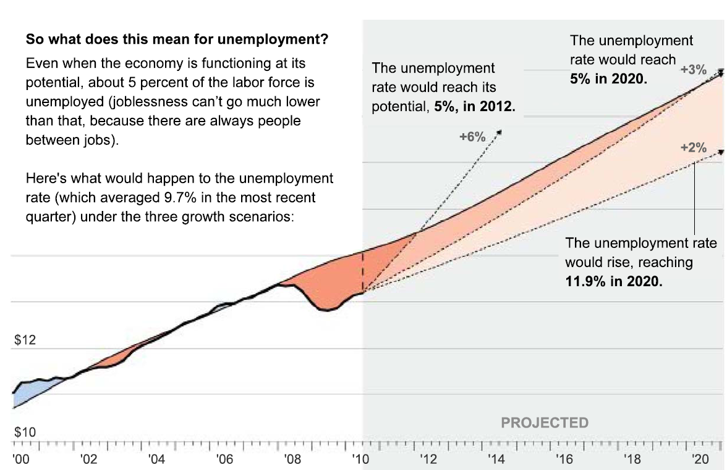
Currency, the financial crisis and employment?
900 billion “output
gap
With unemployment at 9.7% that’s about 7 million people above the “natural” rate of about 5%. Bergsten estimates that the Asian currency effect is .6 to1.2 million in unemployment. But we can’t easily reproduce his numbers with our models.
Recall Scott estimates returning China bilateral deficit to 2001 levels would generate 2.4 million jobs.
Source for underlying chart: Washington Post, Tuesday Oct 5, 2010, page A9

Slide 12
From Chapter 6 employment opportunities – but what about knock on effects?

Slide 13
Macro Factors – Asia and Oil Exporters running big surpluses – US running big deficit
IMF World Economic Outlook Database, April 2009, IMF Exchange Rates, and USDOL

Slide 14
Why does a deeper understanding of value chains and value added trade matter?
Will help us better understand, among other things:
  Trades net contribution to economic growth.
  Real trade balances on bilateral basis.
  Impact of exchange rate revaluation on trade flows.
  Employment impacts of trade and value chains.
  Better understand global effects/linkages of economic shocks, including natural disasters such as Japan’s earthquake and tsunami.
  Full range of interested parties in trade disputes – including unexpected third country opposition, or downstream domestic concerns in AD/CVD cases..
  Better understanding of true distribution of environmental impact/GHG emissions resulting from trade.
  Better estimates of the true sources of sophistication in a country’s exports.
  Real size/impact of tariffs and NTMs on trade.
  Better estimates of concepts from “revealed comparative advantage” to gravity models of trade.
  Better understand and measure role of quality institutions and policy transparency/stability, implications for deep vs. shallow RTAs.
This new WTO/IDE-JETRO publication takes major steps toward helping us answer these important questions.

Slide 15
Thank you.

