Slide 1


KCS’ Single Window History
1
Building the Single Window System
1st phase
Basic System
Period : AUG ‘04 ~ MAR ‘06
Scale : 2,600 Mil. KRW (2.6 million USD)
Connection with 8 agencies such as KFDA and NVRQS
2
Extending the Single Window System
Single Window
2nd phase
Extended System
Period : MAR ‘06 ~ FEB ‘07
Scale : 1,400 Mil. KRW (1.4 million USD)
Connection with 12 agencies (adding 4 more agencies including KTR)
3rd phase
Advanced
System
3
Improve the Single Window system
Period : JAN ‘08 ~ JUL ‘08
Scale : 1,700 Mil. KRW (1.7 million USD)
Improving function and service for user convenience
Connection with 15 agencies (adding 3 more agencies such as FITI testing and research institute)

Slide 2
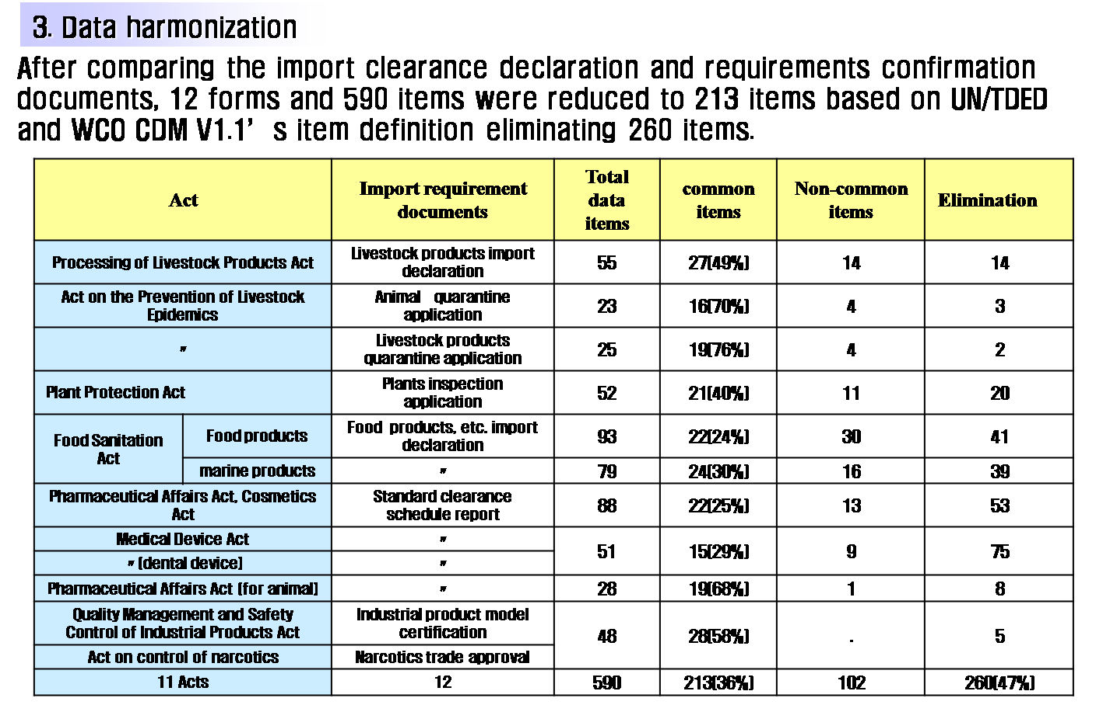
Data Harmonization

Slide 3

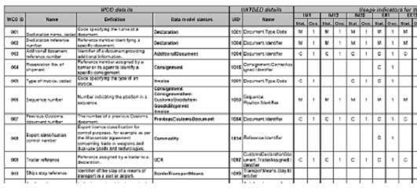
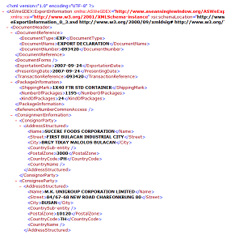
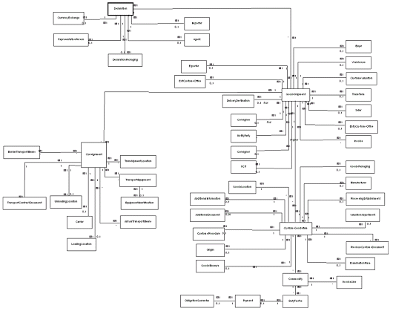
Standardized Document Design
Form
ITEM
DOCUMENT
Making
STRUCTURE
1. Export Declr. -> EX1
2. Import Declr.-> IM1
3. Export Manifest -> CRE
4. Import Manifest -> CRI
5. Entry&Departure-> CONV
6. Bonded Trans. -> TRT

Slide 4

Lessons Learned
Success Factors
Failure Factors
Lack of best practices
Compete with other government authorities
Data ownership
Inconsistent government policy
Data standardization
Inconvenient services at the early stage
Not mandatory
Strong political support
Completion of e-Customs Project
Sufficient allocation of government budget
Active support from private sectors
Free of charge (internet-based system)
Customer-oriented services
Low maintenance expenses
Phased implementation

